Slide 1



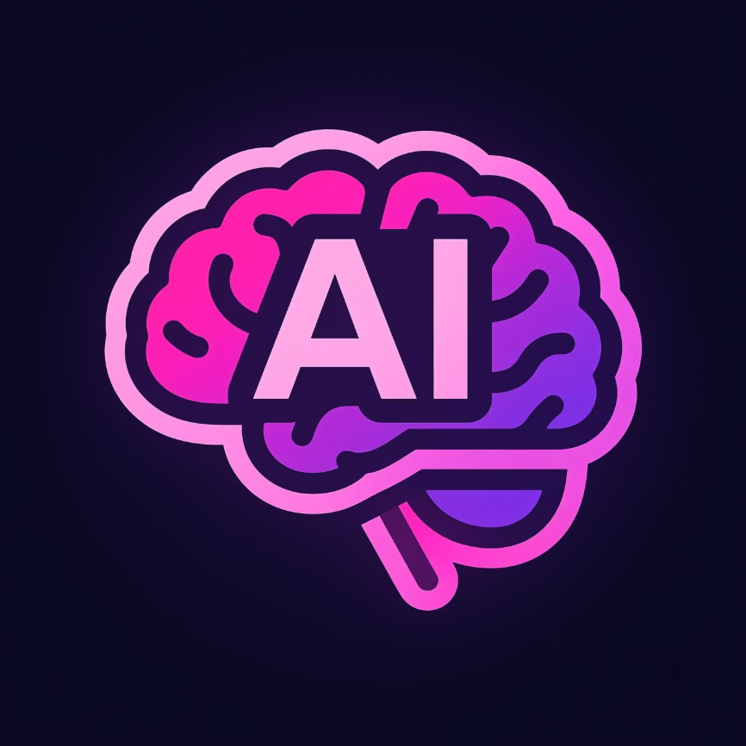

A Presentation for
AI-Based Personalized Learning System
Course & Details
Course Code: CSE 315
Date: October 31, 2025
Submitted to: Dr. Faiz Al Faisal
Presenters
Name: All-amin (ID: 213002019)
Name: Md Manik Ali (ID: 213002265)

Slide 2

The Challenge: Diversity in Learning
Traditional one-size-fits-all education often fails to meet the diverse needs of students. Our project addresses this gap through personalization.
Variable Pace
Learning Gaps
The Solution
Every student absorbs information and masters concepts at a unique pace. Some advance quickly, while others require more time and repetition to grasp core concepts.
When instruction is uniform, some students are left behind, leading to cumulative knowledge deficits that hinder future success.
Personalized learning systems are designed to adapt instructional material, pace, and feedback to the individual needs of each student.

Slide 3


Defining Personalized Learning
Personalized learning is an educational approach where teaching methods and content are dynamically adjusted to fit the specific needs and skills of the learner.
Adaptive Instruction
The system's instructional approach automatically changes based on continuous assessment of the student's current proficiency level.
Content Customization
Learning materials, examples, and difficulty levels are modified to match the student’s evolving skill profile.
Practical Examples
This includes adaptive assessments, customized homework sets, and online courses that adjust material flow based on performance.

Slide 4




The Engine of Personalization: The Role of AI
Artificial Intelligence is crucial for enabling personalization at scale by processing vast amounts of data and making intelligent, real-time decisions about the optimal learning path.
Data Ingestion
Output & Action
Analysis & Modeling
Analyzes Student Data
Identifies Mastery and Deficits
Provides Real-Time Feedback
AI uses machine learning models to parse performance metrics, time spent on tasks, and interaction patterns.
It accurately pinpoints where a student excels and where foundational knowledge is missing.
This analysis is used to deliver instant, customized guidance and recommend the next most relevant learning activity.

Slide 5




System Architecture: Key Modules
Our proposed AI-based system operates on a feedback loop managed by three core, interconnected components.
Data Collection Module
Gathers continuous input on student interactions, including quiz scores, assignment results, reading time, and engagement metrics.
AI Analysis Module
Utilizes algorithms to model student knowledge, predict performance, and determine the optimal next step in the learning sequence.
Content Delivery Module
Selects, formats, and presents the most appropriate educational content (videos, exercises, explanations) to the student.

Slide 6








The Personalization Loop: How AI Works in Practice
AI Performance Analysis
Activity or Quiz Completion
The system immediately processes the results to update the student’s current mastery profile.
Personalized Content Delivery
Feedback and Improvement
Student interaction with the new content serves as feedback, restarting the cycle for continuous optimization.
Based on the analysis, new content (review, challenge, or next topic) is recommended.

Slide 7

Key Advantages of AI Personalized Learning
Implementing an AI-based system offers profound benefits for students, educators, and institutions.
Enhanced Learning Quality
Reduction of Learning Gaps
By focusing instruction precisely where it is needed, the system maximizes comprehension and knowledge retention.
The adaptive nature ensures that foundational deficits are addressed immediately, preventing them from hindering future progress.
Teacher Augmentation
Real-Time Progress Tracking
Automating content adaptation frees educators from routine tasks, allowing them to focus on high-impact interactions and deeper student engagement.
Educators gain immediate, actionable insights into student performance, allowing for proactive intervention.

Slide 8




Critical Challenges in Adoption
While the potential is significant, widespread adoption of AI personalized learning must overcome several practical hurdles.
Data Privacy Concerns
Handling sensitive student performance data requires robust security measures and clear ethical guidelines to ensure trust and compliance.
Technology Cost & Infrastructure
Developing, deploying, and maintaining sophisticated AI systems can be expensive, posing a barrier for resource-limited institutions.
Student and Educator Acceptance
Successful implementation requires training for educators and ensuring students understand and embrace the new learning model.

Slide 9
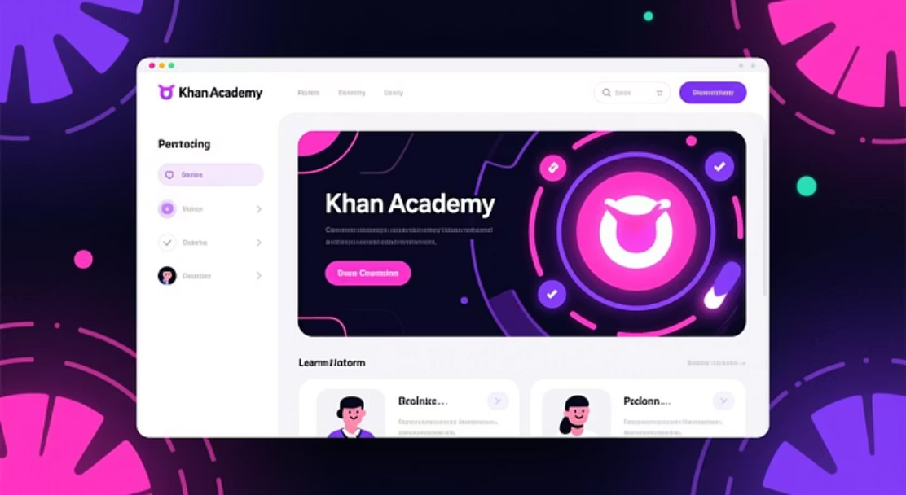
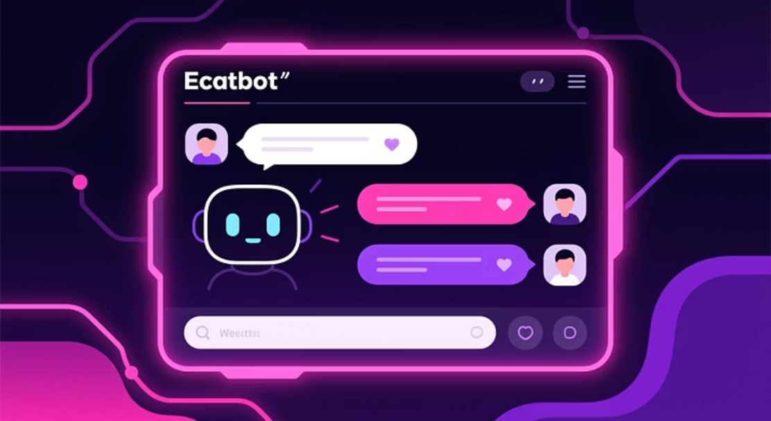
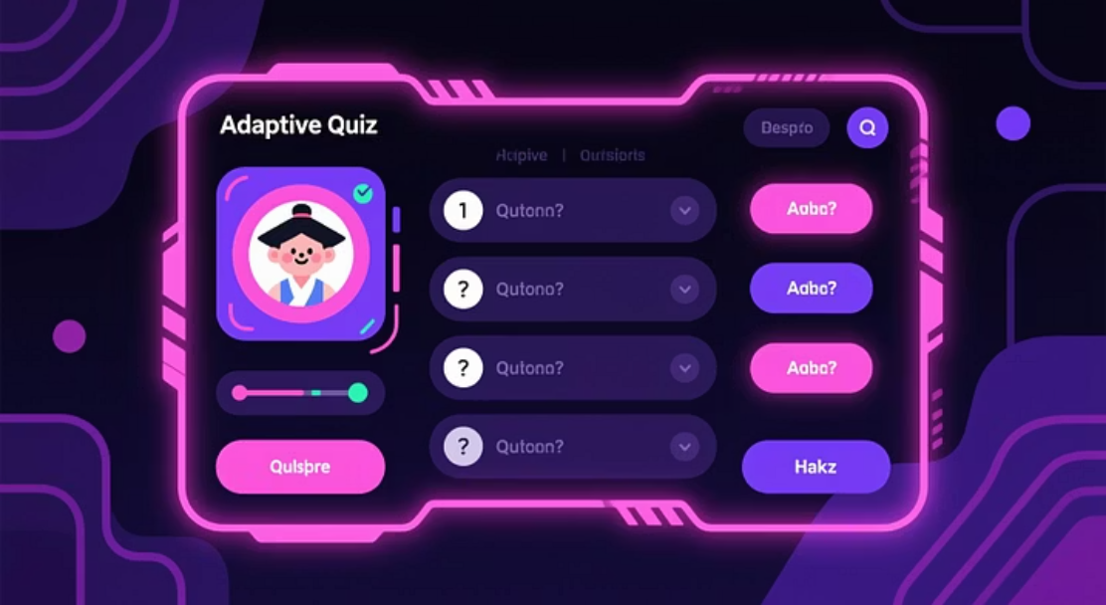
AI in Practice: Real-World Applications
Several platforms have already integrated AI features to deliver personalized and adaptive educational experiences.
Adaptive Quizzing
AI-Powered Chatbots
Platform Integration
Quizzes adjust difficulty and topic coverage in real-time based on the student's previous answers.
These systems provide instant, 24/7 student support, answering questions and guiding learners through course material.
Leading educational providers, such as Khan Academy, use AI to map out mastery paths and recommend individualized lessons.

Slide 10

Conclusion: The Future of Education
AI-based personalized learning represents a paradigm shift toward a more equitable and effective educational model.
AI is essential for tailoring education to the unique cognitive rhythm of every student, maximizing both engagement and academic outcomes.
1:1
+25%
Key Takeaways
AI is the driver for truly personalized learning experiences.
Individualized Pace
Predicted Engagement
The system enhances student outcomes and boosts teacher efficiency.
Addressing ethical and technical challenges is crucial for widespread future adoption.
Delivering instruction that matches the needs of a single student, not a whole class.
Studies show a significant increase in student motivation with personalized content.

Slide 11
References
AI-based Personalized E-Learning Systems: Issues, Challenges and Solutions
This comprehensive research paper from ResearchGate (2023) delves into the intricacies of AI-driven personalized e-learning, discussing key challenges and potential solutions.
Read the full paper on ResearchGate

